Slide 1
Lecture 4.3 Two-Part Tariffs

Slide 2
two-part tariffs
There are two components to the price paid by a consumer
a price per unit (e.g. P = MC)
a fee to join (e.g. F =CS)
To buy q units, the consumer pays:
P_{bundle} = F + Pq
Examples: phone plans, theme parks, electricity plans, razors

Slide 3
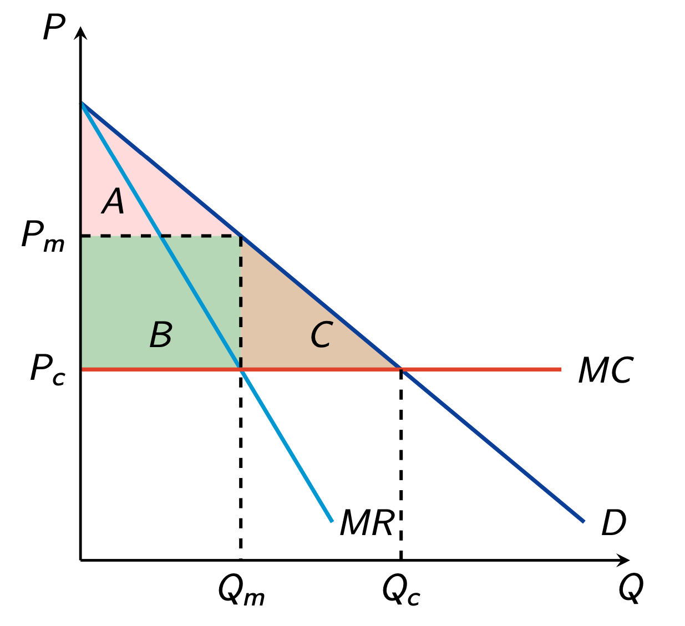
two-part tariffs
To sell Qc, the firm must charge P_{c} < P_{m}
Charge fee: F=A+B+C
Monopolist captures all consumer surplus and the previous deadweight loss
Higher profits than single-price monopolist

Slide 4
Two-part tariffs
With heterogeneous consumers the problem becomes a little more complex.
Suppose we have two types of buyers – a high and low willingness to pay type.
If we set per unit price = MC, the best we can do is to set the fixed fee at the consumer surplus of the low type consumer.
The optimal two-part tariff may involve a unit price different to MC

